Slide 1
Running an OpenShift On Your WorkStation
June 2018 | Leon Levy <llevy@kovarus.com>

Slide 2
AGENDA
OpenShift Overview
MiniShift Overview and Install
Logging Into OpenShift
Deploy and Manage a Simple Application
Java Microservice Application Demo
Additional Topics for Next Time

Slide 3
OpenShift Container Platform
“vCenter for Containers”
Unite developers and IT operations on a single platform to build, deploy, and scale applications

Slide 4
OpenShift at a glance
PaaS
Deploy application container from source S2I (Pod)
Scale application pods for availability and load balancing
Roll out code changes to different environments test/staging/production
On-prem/Off-prem
Virtual or physical servers
CI/CD pipeline integration

Slide 5
OpenShift Environment Architecture 101

Slide 6
CI/CD Pipeline

Slide 7
MiniShift Overview Installation and Application Deployment
Minishift is a tool that helps you run OpenShift locally by running a single-node OpenShift cluster inside a VM. You can try out OpenShift or develop with it, day-to-day, on your local host.

Slide 8
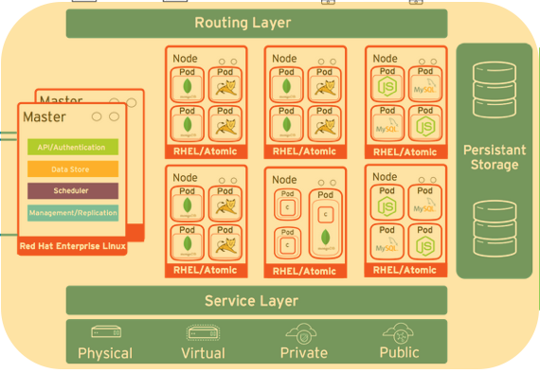
MiniShift Environment
Runs in a single VM
Part of Red Hat Container Development Kit (CDK)
Not Intended for production
Only accessible from workstation

Slide 9
MiniShift Prerequisites
Red Hat Developer Account (Free)
https://developers.redhat.com
Git client and Github account (if you want to modify code examples)
https://git-scm.com
https://github.com
IDE (PyCharm CE/Atom/Notepad++)
Basic git knowledge
git clone/add/commit/push

Slide 10
Windows Prerequisites
A virtualization platform (hypervisor): Hyper-V or VirtualBox.
Hardware extensions (VT-x or AMD-V) are enabled in your system’s BIOS
Shell/environment/PATH variable settings
https://developers.redhat.com/products/cdk/hello-world/

Slide 11
Download and install CDK
https://developers.redhat.com
Products -> Developer Tools -> Red Hat Container Development Kit -> Download (https://developers.redhat.com/products/cdk/overview/)
Includes
MiniShift (MiniShift RHEL VM and startup scripts)
OC (OpenShift CLI)
VirtualBox (latest supported version)

Slide 12
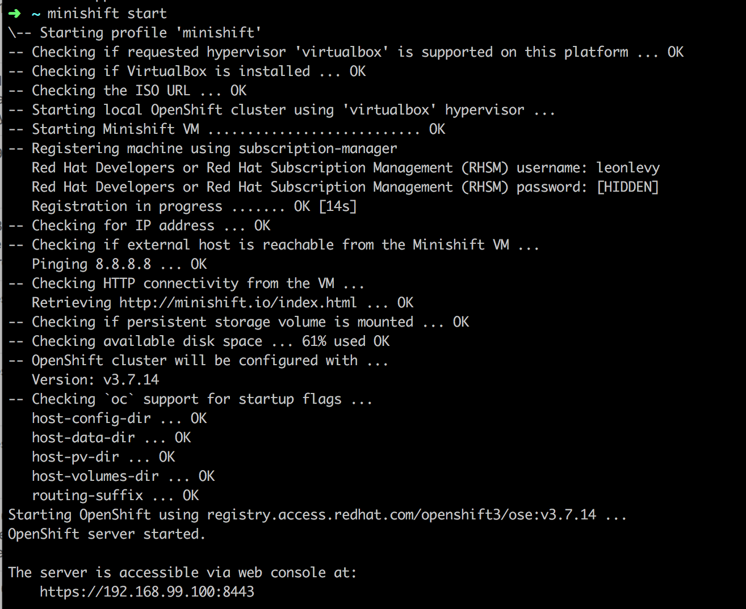
Start Minishift
Via command line
minishift start

Slide 13
Login to MiniShift CLI and WebUI
CLI
oc login https://<ip address from startup>:8443
WebUI
Point browser to https://<ip address from startup>:8443
Username/Password – developer/dev

Slide 14
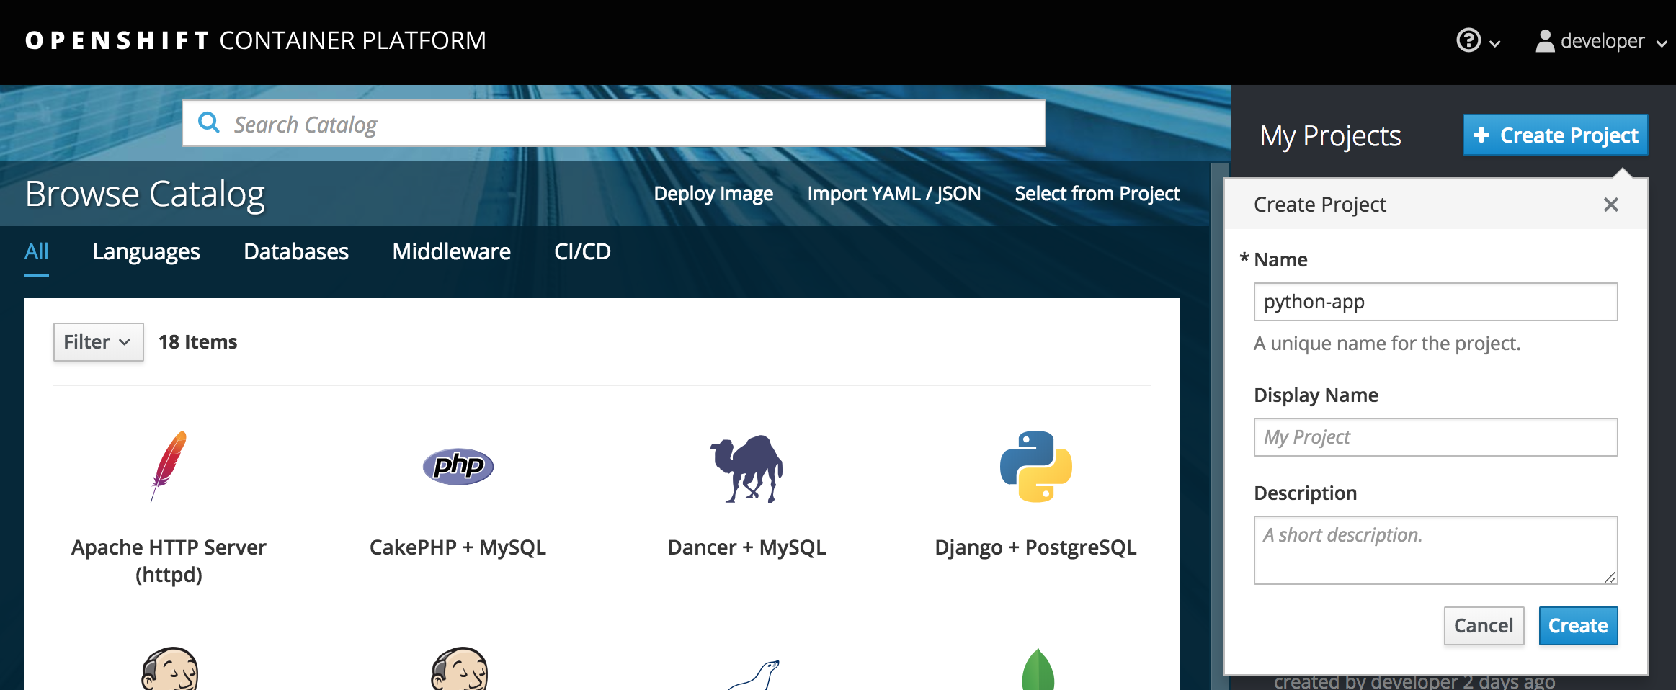
Create a new project
CLI
oc new-project python-app
WebUI

Slide 15
Create new application in project
More than one way to do this
Direct from local build (maven fabric8 module in java)
Deploy a prebuilt container
S2I from git repo
Sample Python/Flask Application
https://github.com/bugbiteme/os-sample-python-flask

Slide 16
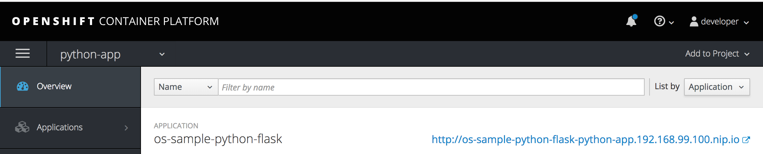
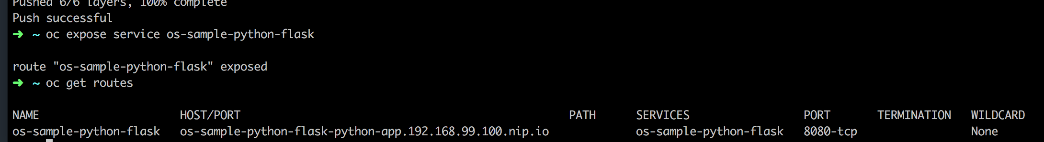
Deploy Python application S2I
oc new-app python:2.7~https://github.com/bugbiteme/os-sample-python-flask.git
oc logs -f bc/os-sample-python-flask
oc expose service os-sample-python-flask
oc get routes

Slide 17
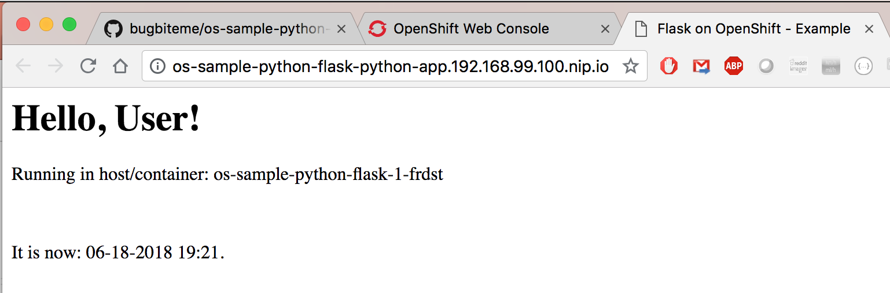
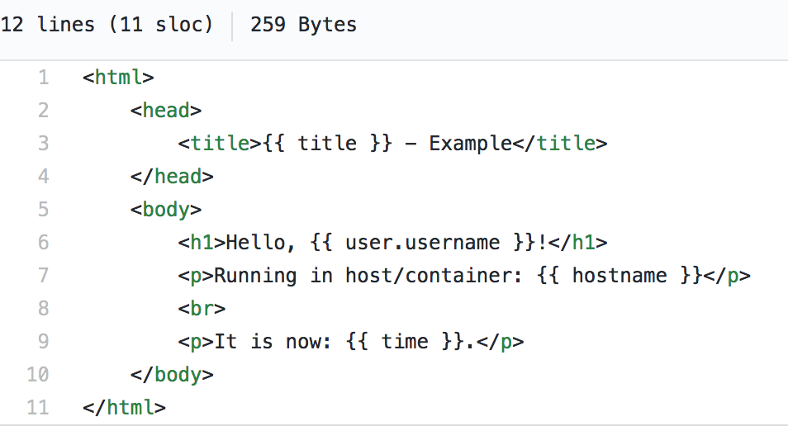
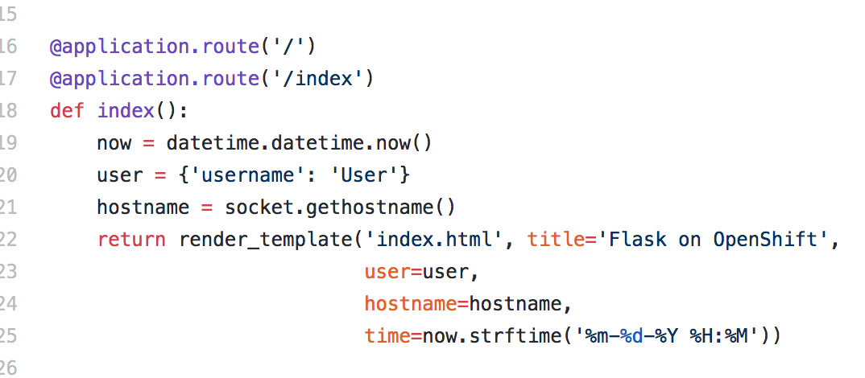
Python App

Slide 18
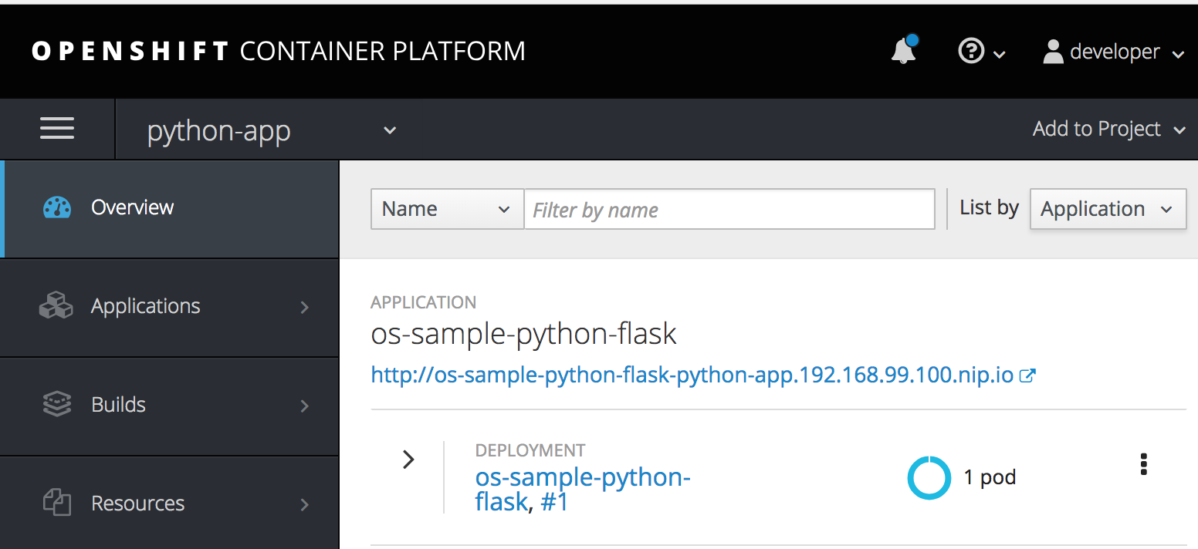
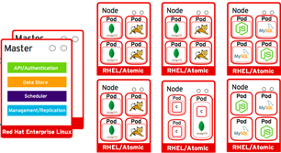
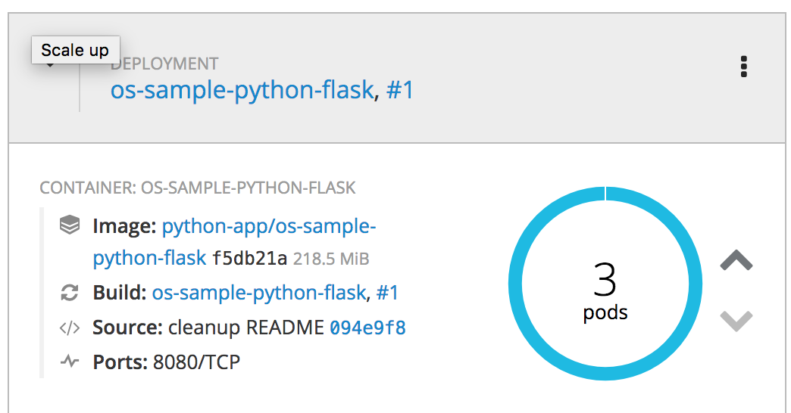
Scaling application
oc scale --replicas=3 dc os-sample-python-flask

Slide 19
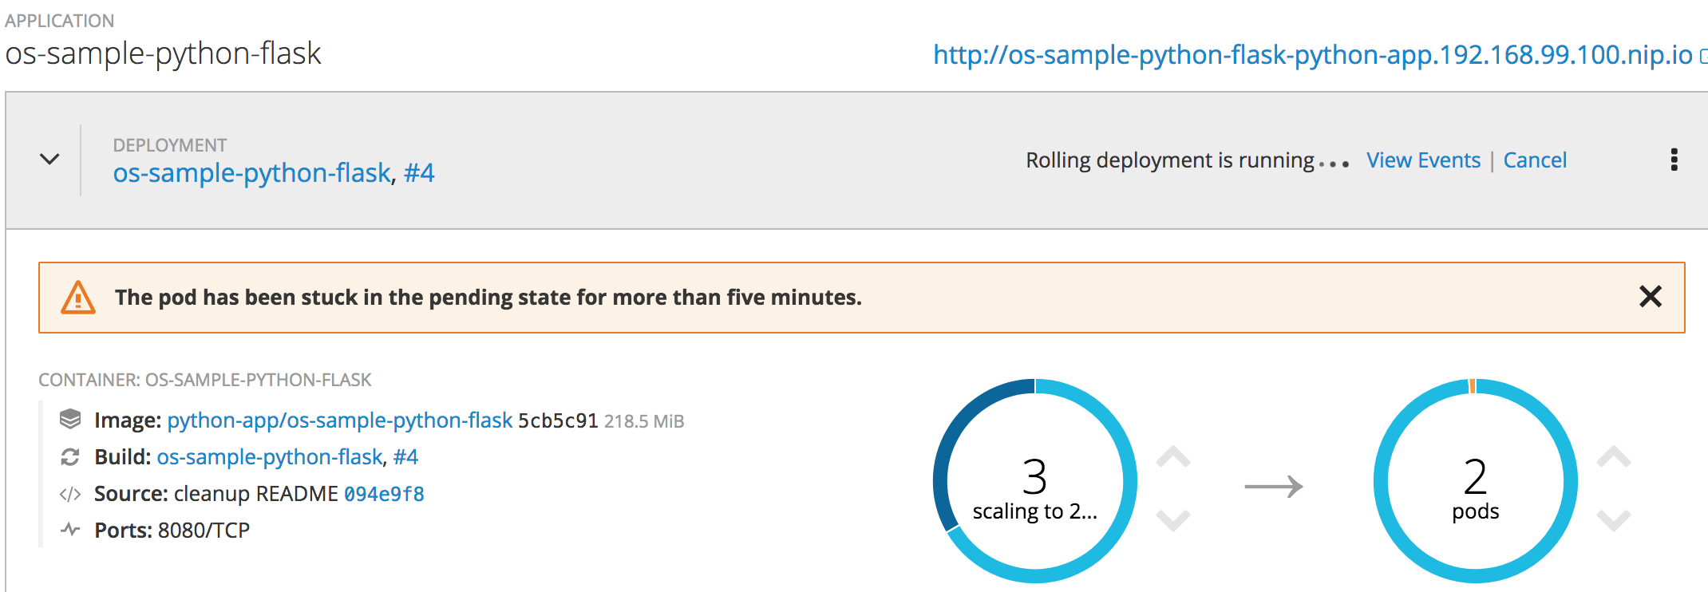
Deploy Build (i.e. code changes)
oc start-build os-sample-python-flask
oc logs -f bc/os-sample-python-flask (track build progress)

Slide 20
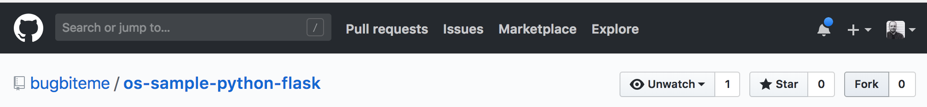
Code change example (using git) Slide 1 of 3
Go to https://github.com/bugbiteme/nodejs-hello-world
Fork project to your own account
Deploy new project and app from forked repo (using Web GUI or CLI)
oc new-project python-app2
oc new-app python:2.7~https://github.com/<your repo>/os-sample-python-flask.git
oc expose service os-sample-python-flask
oc get routes
Make sure app deployed as expected (view via web browser)
Scale to 3 instances
oc scale --replicas=3 dc os-sample-python-flask

Slide 21
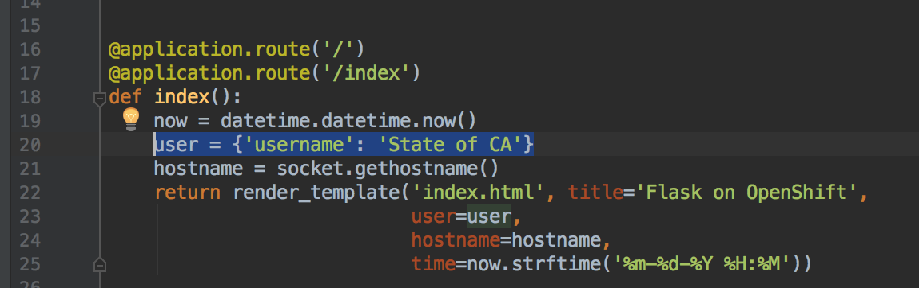
Code change example (using git) Slide 2 of 3
Clone forked repo to local system
git clone https://github.com/<your repo>/os-sample-python-flask.git
Change some code!
cd os-sample-python-flask
Edit wsgi.py (vi, notepad++, PyCharm, Atom, etc…)

Slide 22
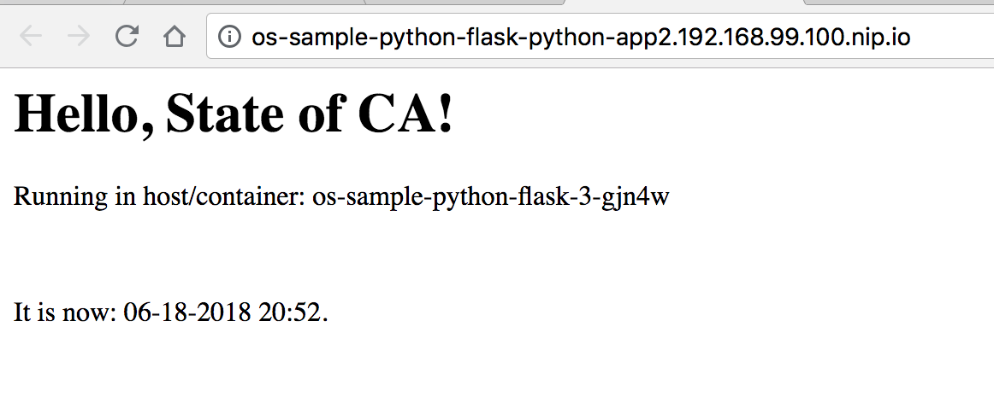
Code change example (using git) Slide 3 of 3
Save code and check changes into github repo
git add *
git commit -m "doing some code changes”
git push
Build and deploy code changes
oc start-build os-sample-python-flask; oc logs -f bc/os-sample-python-flask
Refresh web-browser to view changes

Slide 23
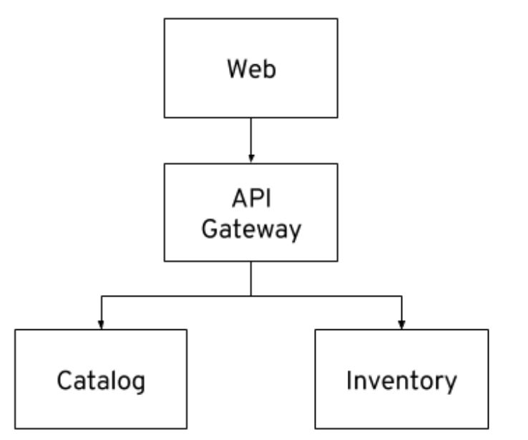
Java Microservice Application Demo

Slide 24
TITLE - ALL CAP
Statement Slide – Can be used for themes, quotes, big ideas, and messages

Slide 25
Sample Content Slide
Bullet 01
Bullet 02
Bullet 03
Bullet 04

Slide 26
PLACE LOGO
Cast Study Slide: Place quotes here

Slide 27
Main Quote here “The Kovarus Proven Solutions Center can reassure IT decision makers of their decisions, enabling them to see and really understand solutions before purchasing them.”
Name, Title, Company Name

Slide 28
Color Palette
Primary
Kovarus BLUE
Kovarus SAPPHIRE
31-73-125
1-122-180
Secondary Spot Colors
STEEL
ORANGE
TANGERINE
LEMON
OLIVE
169-169-169
241-96-0
252-155-0
255-183-0
141-160-5

Slide 29
Chart Sample

Slide 30
Graph Sample

Slide 31
SECTION TITLE

Slide 32
Sample Icons

Slide 33
THANK YOU!

